Slide 1
Weather-Based Outfit Suggestion App
Prepared by [Abdullah Zunorain]
Date: [14-Dec-2024]

Slide 2
Introduction
Overview of the Concept:
Develop an application that combines real-time weather data with outfit suggestions.
Purpose:
Helps users select weather-appropriate outfits for comfort, safety, and style.

Slide 3
Problem Statement
User Pain Points:
Difficulty in choosing weather-appropriate outfits, especially with sudden weather changes.
Checking weather manually and deciding wardrobe choices is inconvenient.
Market Need:
Lack of personalized, weather-based outfit suggestion apps in the market.

Slide 4
Aim
Primary Aim:
Develop an app that provides outfit suggestions based on real-time weather conditions and user preferences.

Slide 5
Objectives
Real-Time Weather Integration
User Preferences
Personalized Suggestions
Sustainability Focus
Accessibility and Convenience

Slide 6
Methodology
Weather Data Collection:
Use APIs to get real-time weather.
Outfit Suggestion Algorithm:
Match weather data with clothing choices.
User Profile & Preferences:
Allow users to input preferences.
Machine Learning :
For better personalization.
App Development and Testing:
Use frameworks like Google Colab and Hugging Face

Slide 7
Application Steps
The following steps are involve in developing an application
Model Selection (llama from Groq)
API (groq and openweathermap)
Google Colab
For Testing
Hugging Face
For Deployment

Slide 8
App Work Flow
User Interface (UI)
Home Screen: A welcoming screen where the user can sign in, set location, and see the current weather.
Weather & Outfit Screen: Displays the current weather and recommended outfits based on user settings and location.
Settings: Allows the user to set preferences, e.g., style, temperature sensitivity, favorite clothing items, etc.
Wardrobe & Saved Outfits: Allows the user to view their wardrobe, save recommended outfits, or create custom looks.
Data Collection and Input
Location Detection: Use GPS or user-provided location to get the user’s current city or region.
Weather Data Retrieval: Integrate a weather API (e.g., OpenWeatherMap or Weatherstack) to fetch real-time weather data based on the location.
Weather Information Needed: Temperature, humidity, wind speed, precipitation, etc.

Slide 9
App Work Flow
3. Weather Analysis
Weather Classification: Based on weather data, classify conditions as hot, warm, cool, cold, rainy, windy, etc.
Outfit Category Mapping: Map each weather category to general outfit categories (e.g., raincoat and boots for rain, light layers for warm weather).

Slide 10
App Work Flow
4. Outfit Recommendation Engine
User Profile & Preferences: Store user information like style preferences, common color choices, temperature comfort range, and sensitivity (cold-tolerant or cold-sensitive).
Outfit Database: A database containing clothing items, categorized by type (e.g., tops, bottoms, accessories) and weather suitability (e.g., jackets for cold, shorts for warm).
Basic Filtering: Filter outfits by current weather, user preferences, and clothing availability.
AI Outfit Suggestions : Use a machine learning model (like collaborative filtering or content-based filtering) to recommend specific items based on user behavior (e.g., past likes/dislikes).
Styling Rules: Ensure suggested outfits meet basic styling rules (e.g., match colors, balance formality).

Slide 11
App Work Flow
5. Analytics & Improvement
Usage Analytics: Track outfit suggestions, user feedback, and frequently selected items to analyze trends.
Model Retraining (if using AI): Periodically retrain the recommendation model based on accumulated data to refine outfit suggestions

Slide 12
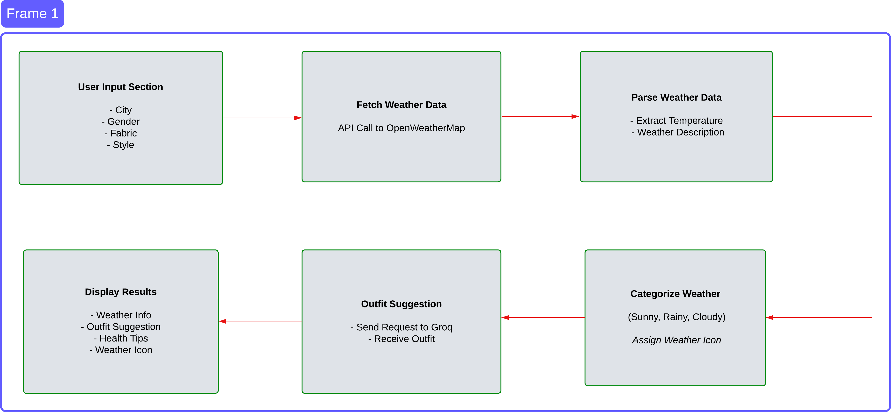
App Work Flow

Slide 13
Application
User Journey:
Displays app flow from weather data input to outfit suggestions.
Example Scenarios:
Outfit suggestions for rain, snow, sunny, and windy conditions.
User Interface:
Highlights unique features like notifications and fashion trends.

Slide 14
Benefits
Time-Saving
Comfort and Safety
Sustainable Fashion Encouragement
Improved User Satisfaction

Slide 15
Conclusion
Summary:
Design an application that integrates real-time weather data to provide customized outfit recommendations.
Helps users select weather-appropriate outfits for comfort, safety, and style.
Future Plans:
Potential for features like social sharing, wardrobe integration, and a virtual closet.
Closing Statement:
Emphasizes the app’s role in enhancing daily experiences by integrating technology, fashion, and weather insights.

Slide 16
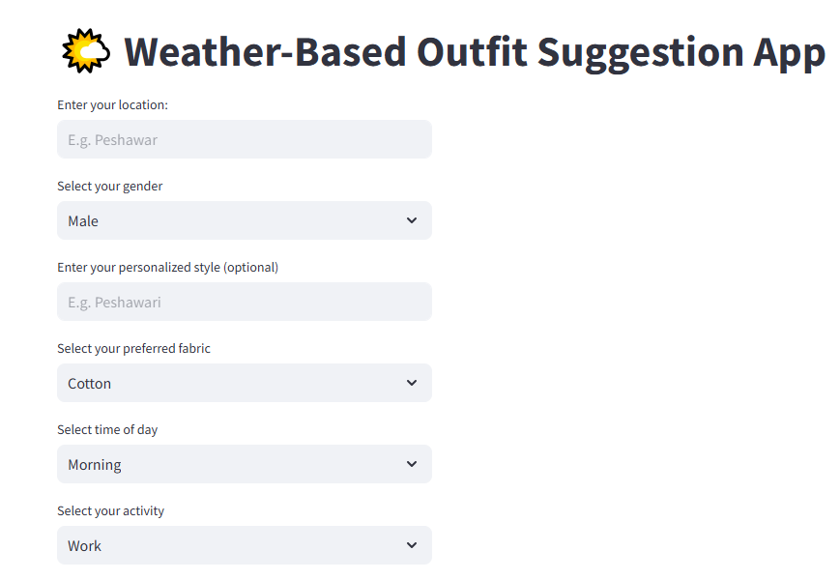

Slide 17
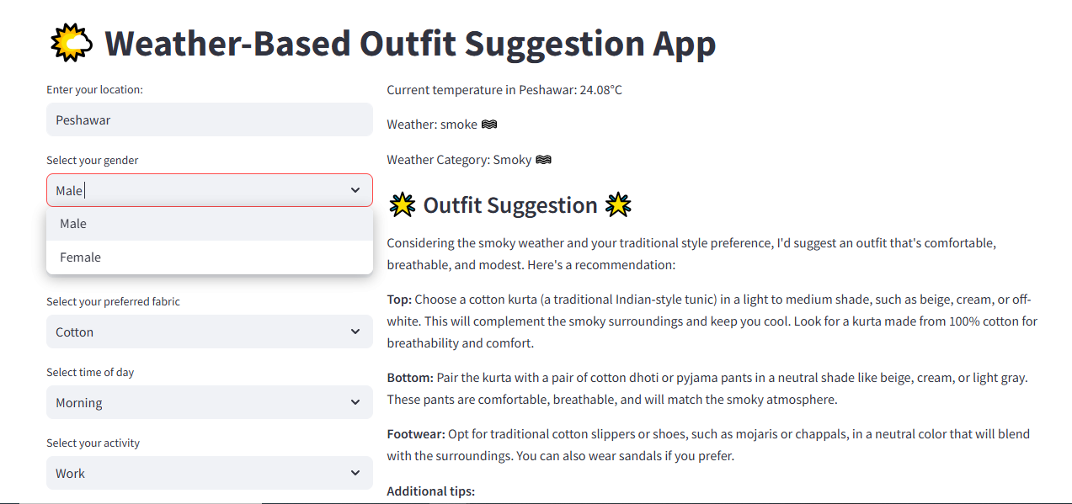

Slide 18
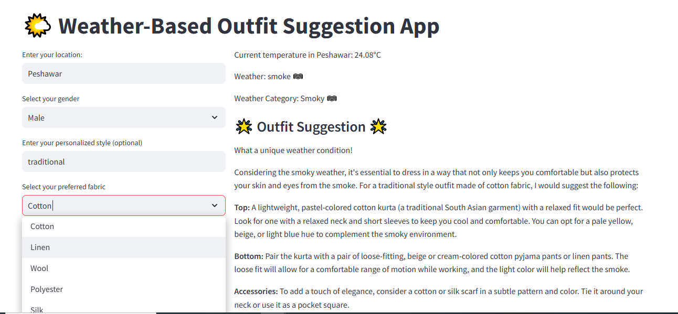

Slide 19
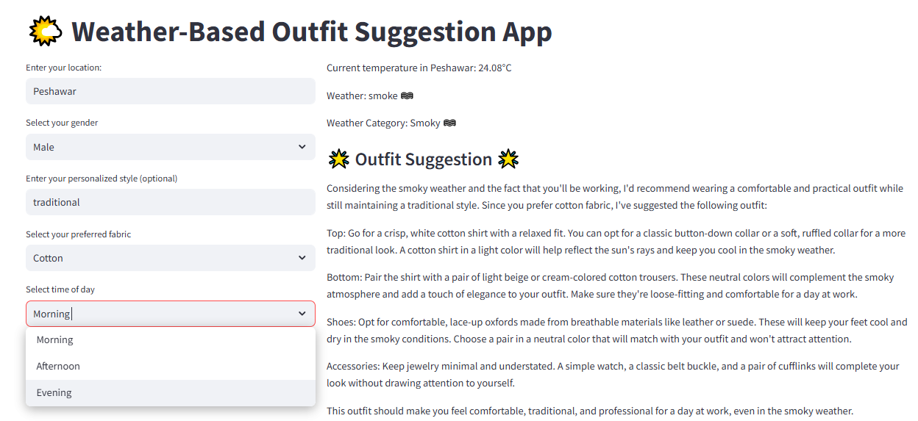

Slide 20
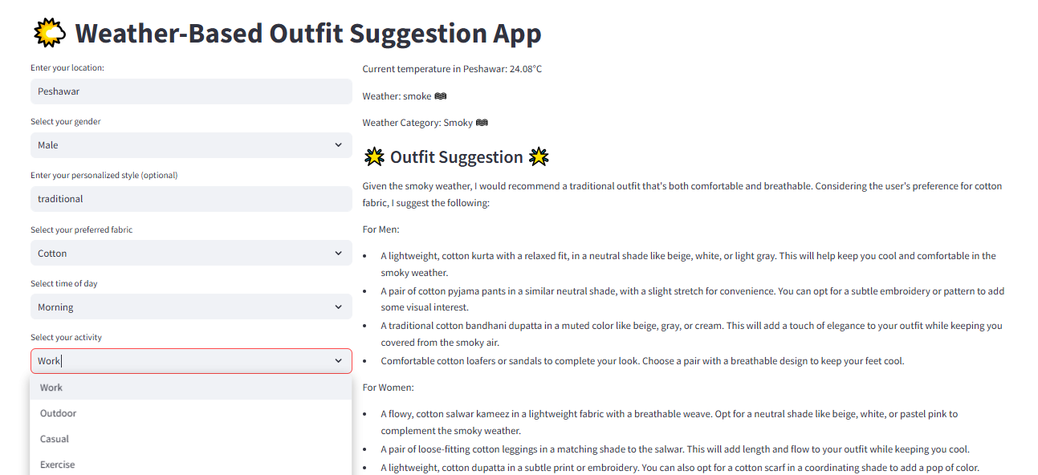

Slide 21
Thank You

